Slide 1

Cross Platform Mobile and Web Apps Development
Day 1

Slide 2
Major Mobile Operating Systems
The three major operating systems for mobile devices
Android by Google
iOS by Apple
Windows 8 by Microsoft
Android devices: native apps written in Java using Android Software Development Toolkit (SDK).
Apple devices: native apps written in an integrated development environment (IDE) called Xcode.
Windows mobile devices: native apps written in .Net framework.
Cross-platform development
well-established HTML—HyperText Markup Language.
a response to the changing nature of the Internet.

Slide 3
jQuery Mobile
jQuery Mobile is the easiest way to build sites and apps that are accessible on all popular smartphone, tablet, and desktop devices. This framework provides a set of touch-friendly UI widgets and an AJAX-powered navigation system to support animated page transitions.
https://learn.jquery.com/jquery-mobile/

Slide 4
Basic jQuery Mobile Page Template
<!doctype html>
<html>
<head>
<title>My Page</title>
<meta name="viewport" content="width=device-width, initial-scale=1">
<link rel="stylesheet" href="https://code.jquery.com/mobile/1.4.5/jquery.mobile-1.4.5.min.css">
<script src="https://code.jquery.com/jquery-1.8.2.min.js"></script>
<script src="https://code.jquery.com/mobile/1.4.5/jquery.mobile-1.4.5.min.js"></script> </head>
<body>
<div data-role="page">
<div data-role="header">
<h1>My Title</h1>
</div><!-- /header -->
<div role="main" class="ui-content">
<p>Hello world</p>
</div><!-- /content -->
<div data-role="footer">
<h4>My Footer</h4>
</div><!-- /footer -->
</div><!-- /page -->
</body>
</html>
https://learn.jquery.com/jquery-mobile/getting-started/

Slide 5
Basic jQuery Mobile Page Template
In the <head> of this template, a meta viewport tag sets the screen width to the pixel width of the device.
References to jQuery, jQuery Mobile, and the mobile theme stylesheet from the CDN add all the styles and scripts. jQuery Mobile 1.4 works with versions of jQuery core 1.8 and newer.
In the <body>, a div with a data-role of page is the wrapper used to delineate a page.
A header bar (data-role="header"), a content region (role="main" class="ui-content") and a footer bar (data-role="footer") are added inside to create a basic page (all three are optional).
These data- attributes are HTML5 attributes used throughout jQuery Mobile to transform basic markup into an enhanced and styled widget.
https://learn.jquery.com/jquery-mobile/getting-started/

Slide 6
jQuery Mobile List View
jQuery Mobile includes a diverse set of common listviews that are coded as lists with a data-role="listview" added. Here is a simple linked list that has a role of listview. The data-inset="true" attribute makes the listview look like an inset module, while data-filter="true" adds a dynamic search filter.
<ul data-role="listview" data-inset="true" data-filter="true">
<li><a href="#">Acura</a></li>
<li><a href="#">Audi</a></li>
<li><a href="#">BMW</a></li>
<li><a href="#">Cadillac</a></li>
<li><a href="#">Ferrari</a></li>
</ul>
https://learn.jquery.com/jquery-mobile/getting-started/

Slide 7
jQuery Mobile Slider
The framework contains a full set of form elements that are automatically enhanced into touch-friendly styled widgets. Here's a slider made with the new HTML5 input type of range, no data-role needed. All form elements must always be properly associated with a <label> and the group of form elements be wrapped in a <form> tag.
<form>
<label for="slider-0">Input slider:</label>
<input type="range" name="slider" id="slider-0" value="25" min="0" max="100" />
</form>
https://learn.jquery.com/jquery-mobile/getting-started/

Slide 8
jQuery Mobile Button
There are a few ways to make buttons. A common one is to turn a link into a button so it's easy to click. Just start with a link and add a data-role="button" attribute to it. You can add an icon with the data-icon attribute and optionally set its position with the data-iconpos attribute.
<a href="#" data-role="button" data-icon="star">Star button</a>
https://learn.jquery.com/jquery-mobile/getting-started/

Slide 9
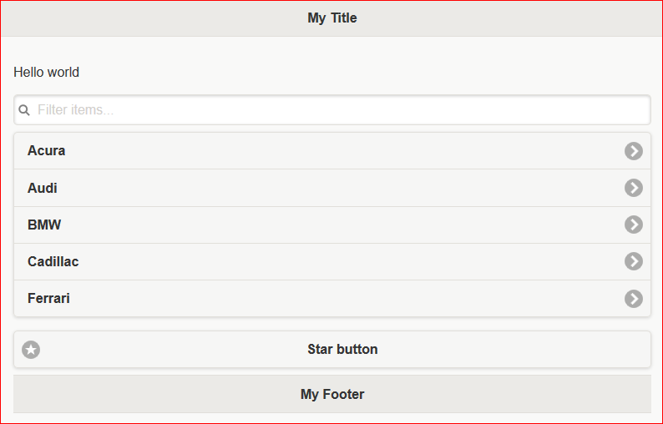
Exercise
Using the code samples from the previous slides create a sample jQuery Mobile web page.
Upload to your web server and test from a mobile device.

Slide 10
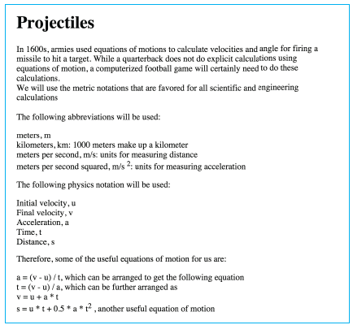
Projectile App Context

Slide 11
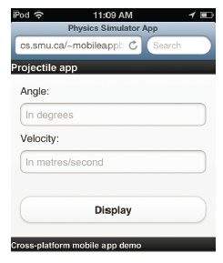
Projectile App Requirements
The app calculates physics data behind launching a projectile.
Calculate the distance of a projectile based on the angle and velocity input by the user.
The calculation page will open first when you start the app.
A menu bar will provide navigation between the two main sections.
Menu bar should be consistent across all sections of the app
Easy to read colors and fonts

Slide 12
Design Considerations
Must consider the end user and the main objectives of the app.
How to organize functionalities.
The core functionality should be the first screen that users see when they access your app.
Other functionalities should be placed in a menu of some sort to provide easy access.
Communication between the app and the user.
Must consider what device or devices users will use to access your app.

Slide 13
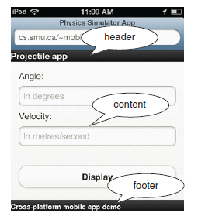
Header, Footer and Content
The body of the web page is wrapped in a pair of <div>...</div> tags with an attribute called data-role whose value is set to "page".
Add three pairs of <div>...</div> tags with data-role set to "content", "header", and "footer".

Slide 14


jQuery Widgets
Use a pair of tags <button>...</button> with the text “Display” inside the tags.
type
name
id
min
Max
Alternatively, use the Anchor tag with data-role=“button” attribute.

Slide 15
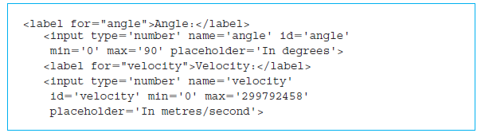
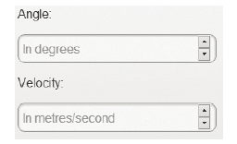
jQuery Input Fields

Slide 16
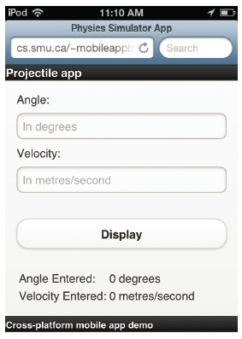
Projectile App Screenshot

Slide 17
Projectile JavaScript Functions
The header section includes another script using the code which includes the file physicsProjectileApp1.js from the folder scripts
<script type='text/javascript‘ src='scripts/physicsProjectileApp1.js'></script>
The code for the button widget has an attribute called onclick that calls a JavaScript function display defined in physicsProjectileApp1.js
<button onclick="display();">
A pair of <table>...</table> tags with two rows and three columns correspond to the two lines below the Display button.

Slide 18
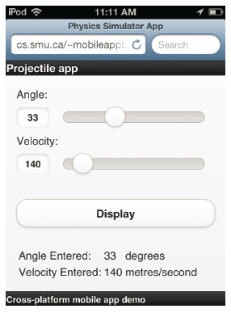
Range Slider Input Widget
In a mobile device with touch-screen facility, we should provide facilities to interact without a keyboard whenever possible.

